Slide 1


Smart shopping cart with automated billing system
Submitted by
Yasir nisar teli (18205135034)
MOHAMMAD AAQIB AHANGER (18205135052)
Junaid ul islam (18205135044)
Submitted To
Department of computer science & engineering
SSM COLLEGE OF ENGINEERING
PARIHASPORA PATTAN, BARAMULAH

Slide 2
Content
Aim and objectives
Introduction
Existing system
Proposed system
Block diagram
RFID Tags
RFID reader
GSM (global system for mobile communication
LCD
ESP32S
Specifications of ESP32
working instructions
Experimental results
Conclusion
Reference

Slide 3
Aim and objective
The aim is to make our shopping easier by using the RFID tags which are attached to each product in the shopping market.
To save time at the billing system.
The main objective for designing this project is to reduce the human efforts, eliminate the waiting queue of customers at shopping malls
Privacy is the important part and it is the key deciding factor of the economic value of the project.

Slide 4
Introduction
The main purpose of this project is to provide centralized and automated billing system using RFID, ESP32 and I2C communication
Each product of shopping mall, super market will be supplied with an RFID tag, to identify its type. Every cart contains a board.
Specifically, board contains a ESP32 Module, LCD with I2C Module, and RFID reader

Slide 5
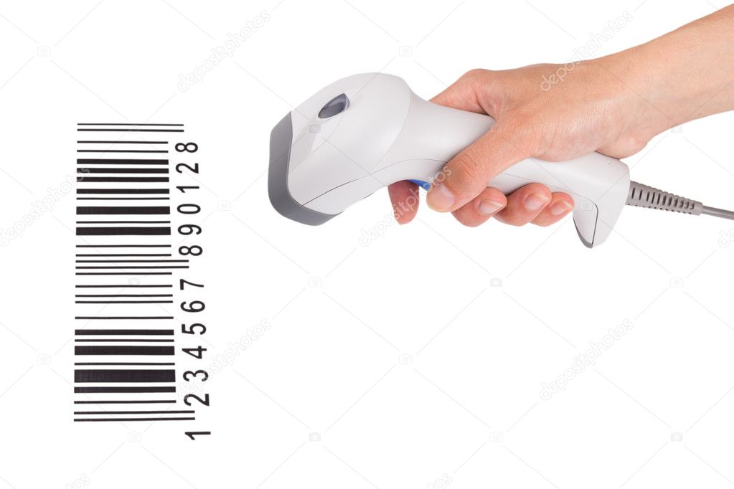
existing system barcode
Person is required to read barcode on product. Barcode must be visible on the surface of product.
Line of sight required to a read barcode. The readability of barcodes can be impaired by dirt, moisture, abrasion, or packaging contours short reading distance.
Barcode does not have READ & WRITE capability.

Slide 6
Proposed system rfid
Automatic reading of RFID tag from product.
RFID tags can be placed inside the product No line of sight required to make the system work.
RFID tags are not affected by such conditions. Long reading distance.
Unlike barcodes, tags can store more information.it follows commands or instructions of reader.
RFID tag having READ & WRITE capability.

Slide 7
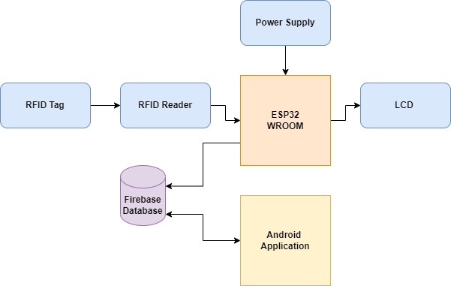
Block diagram
Complete System Block Diagram

Slide 8
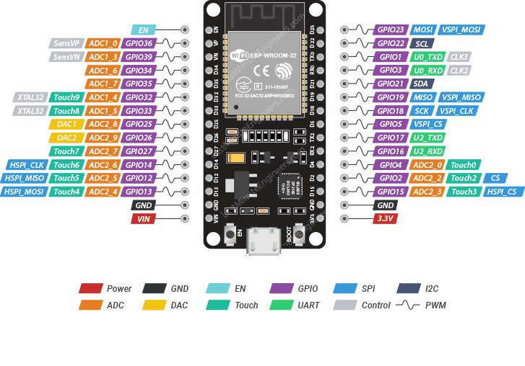
ESP32

Slide 9
the ESP32 Board consists of the following
ESP-WROOM-32 Module
Two rows of IO Pins (with 15 pins on each side)
CP2012 USB – UART Bridge IC
micro–USB Connector (for power and programming)
AMS1117 3.3V Regulator IC
Enable Button (for Reset)
Boot Button (for flashing)
Power LED (Red)
User LED (Blue – connected to GPIO2)
Some passive components

Slide 10
Specifications of ESP32
Single or Dual-Core 32-bit LX6 Microprocessor with clock frequency up to 240 MHz.
520 KB of SRAM, 448 KB of ROM and 16 KB of RTC SRAM.
Supports 802.11 b/g/n Wi-Fi connectivity with speeds up to 150 Mbps.
Support for both Classic Bluetooth v4.2 and BLE specifications.
34 Programmable GPIOs.
Up to 18 channels of 12-bit SAR ADC and 2 channels of 8-bit DAC
Serial Connectivity include 4 x SPI, 2 x I²C, 2 x I²S, 3 x UART.
Ethernet MAC for physical LAN Communication (requires external PHY).
1 Host controller for SD/SDIO/MMC and 1 Slave controller for SDIO/SPI.
Motor PWM and up to 16-channels of LED PWM.
Secure Boot and Flash Encryption.
Cryptographic Hardware Acceleration for AES, Hash (SHA-2), RSA, ECC and RNG

Slide 11
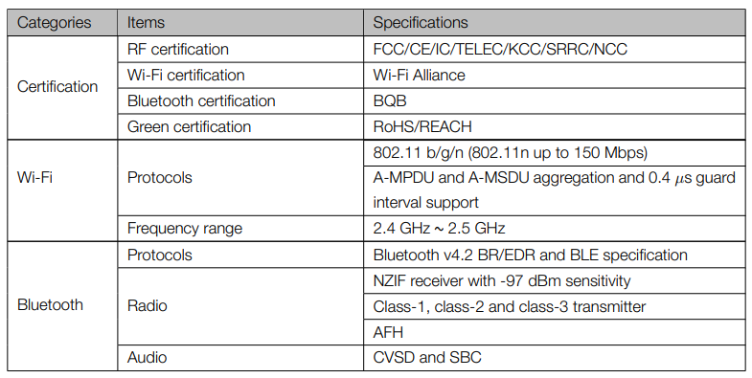
ESP 32 board descripition

Slide 12
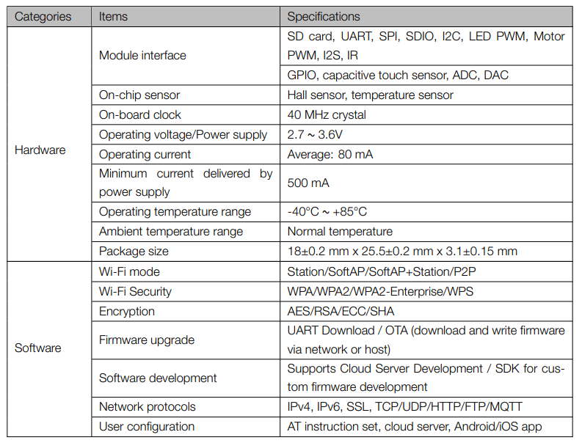
Esp 32 board descripition (Contd)

Slide 13
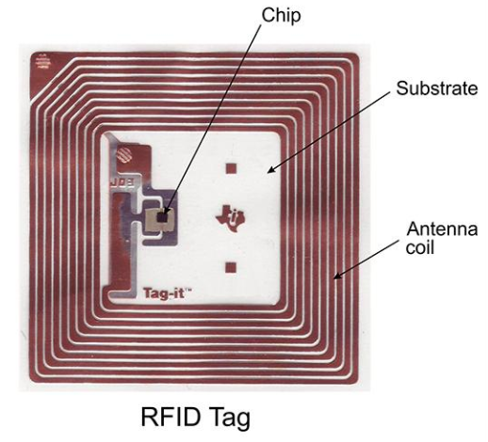
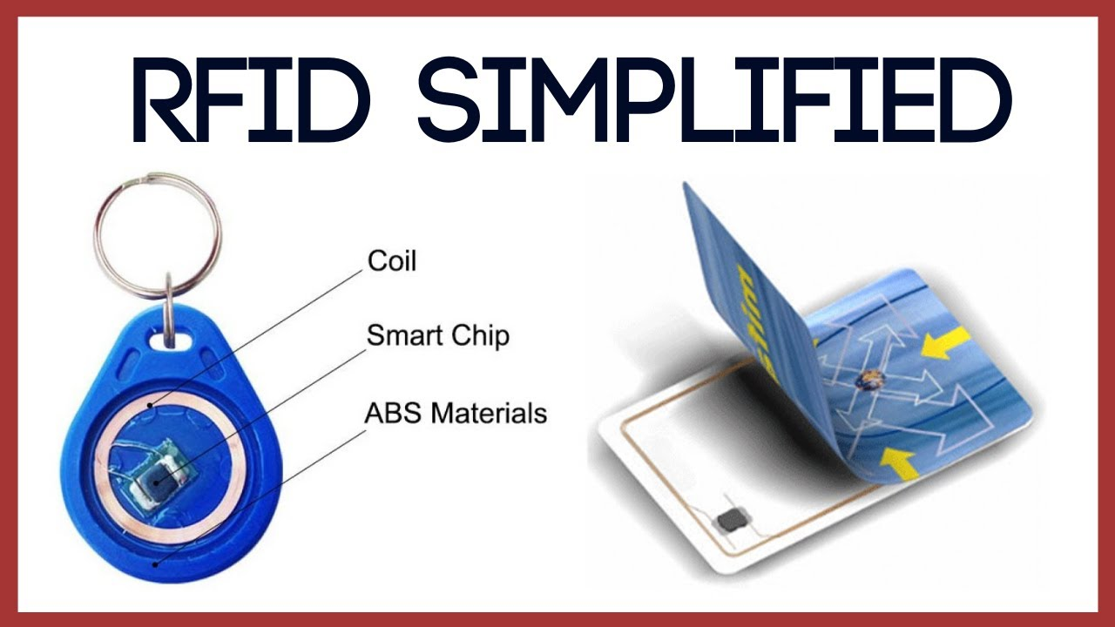
Rfid tags
Passive RFID Tags:
.
RFID tag is an electronic tag that exchanges data with a radio frequency identification (RFID) reader by using radio waves.
Every RFID card has an unique ID number
RFID tags are made up of at least two main parts. The first is an an antenna, which receives radio frequency (RF) waves.
The second is an integrated circuit (IC), which is used for processing and storing data, as well as modulating and demodulating the radio waves received/sent by the antenna.

Slide 14
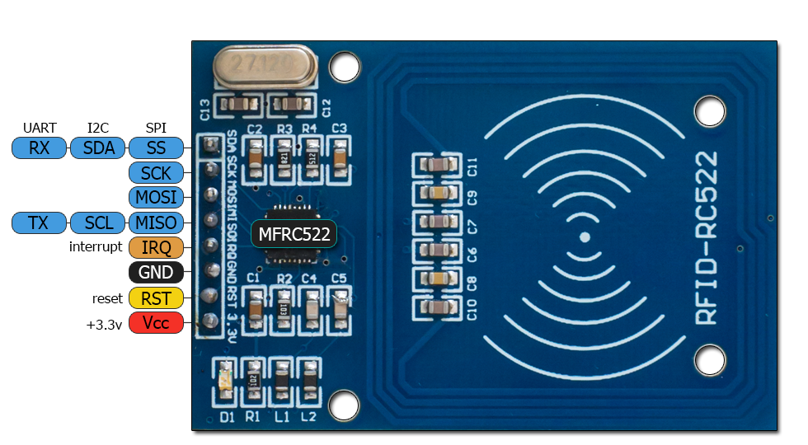
RFID READER
The reader emits radio waves in ranges of anywhere from one inch to 100 feet or more , depending upon its power output and radio frequency used.
Carrier Frequancy : 125KHZ
It is used to read unique ID from RFID tags. Whenever RFID tags comes in range, RFID reader reads its unique ID and transmits it serially to the microcontroller or PC.
RFID reader has transceiver and an antenna mounted on it. It is mostly fixed in stationary position as in our trolly this project.

Slide 15
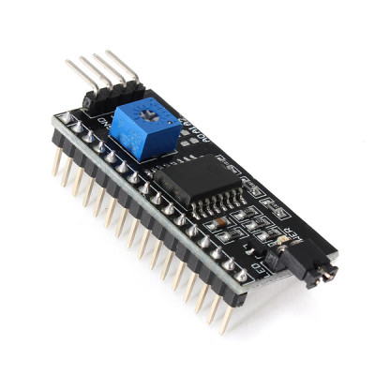
I2C Module
I2C Module has a inbuilt PCF8574 I2C chip that converts I2C serial data to parallel data for the LCD display.
These modules are currently supplied with a default I2C address of either 0x27 or 0x3F. To determine which version you have check the black I2C adaptor board on the underside of the module. If there a 3 sets of pads labelled A0, A1, & A2 then the default address will be 0x3F. If there are no pads the default address will be 0x27.
The module has a contrast adjustment pot on the underside of the display. This may require adjusting for the screen to display text correctly.

Slide 16
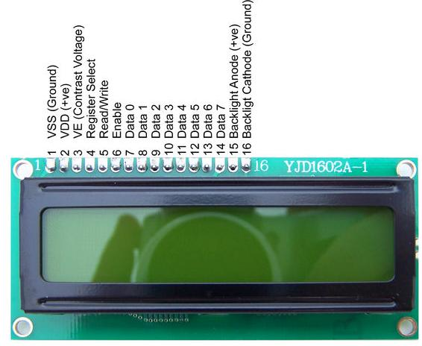
Lcd(liquid crystaldisplay)
The 16x2 LCD has a set of commands each ment for doing a particular job with the display.
LCD display is used in our project to display Brand Name

Slide 17
Algorithm 1 RFID Data Transfer :
Initialisation :
1: Call Bluetooth_connection
2: if Bluetooth == connected then
3: Call Wi_Fi_connection
4: if Wi_Fi == connected then
5: for Scanning = connected to disconnect do 6: Scanning RFID_tag
7: if RFID_tag == Detected then
8: RFID_Data = CALL Transfer(RFID)
9: Display RFID_Data in Mobile device
10: else
11: Show Error try to scan again
12: end if
13: end for
14: else
15: Error in Wi_Fi connection 16: end if
17: else
18: Error in Bluetoot connection
19: end if

Slide 18
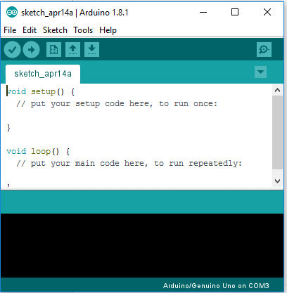

Software used arduino uno software and android aap
Android: Android is a mobile operating system based on a modified version of the Linux kernel and other open-source software
Arduino: The Arduino integrated development environment (IDE) is a cross-platform application (for Microsoft Windows, macOS, and Linux) that is written in the Java programming language. It originated from the IDE for the languages Processing and Wiring.

Slide 19
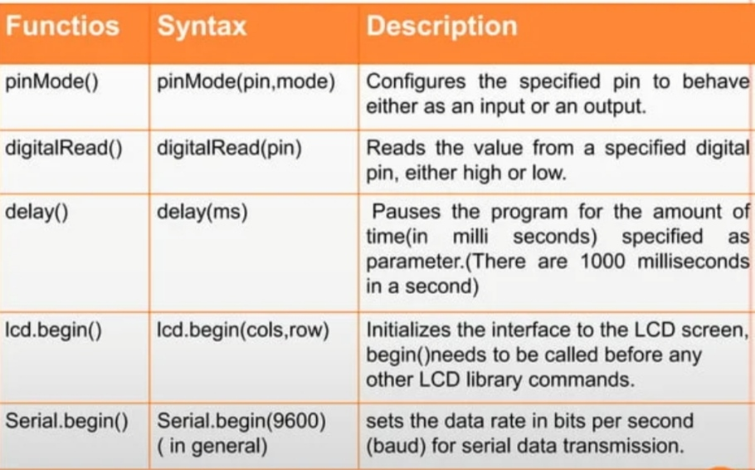
Functions used in Arduino software

Slide 20
working instructions
Step 1: Start
Step 2: When the system is powered up, display the initial data.
Step 3: Scanning of the RFID membership card.
Step 4: If the membership card scan is successful fetch all the personal details & display it on the LCD. If not, scan the membership card once again. Loop repeats until the scanning process is successful.
Step 5: Now the product scanning process is ready. If the scanned product code is detected, display all the product details on the LCD screen. If not, the product has to be scanned until it gets detected. This process applies to each & every product.
Step 6: If a scanned product is scanned once again then that product is removed from the microcontrollers memory & in the ongoing bill [13].
Step 7: Finally, to end the shopping, the shopper has to scan the Membership card. If the card is successfully scanned, then the complete bill summary is displayed on the LCD.
Step 8: Immediately after the bill amount is deducted from the card, an SMS is sent to the prescribed shoppers mobile phone via a GSM module regarding the shopping details [8].
Step 9: Stop.
Step 10: Repeat the entire process if another membership card is scanned & detected.

Slide 21
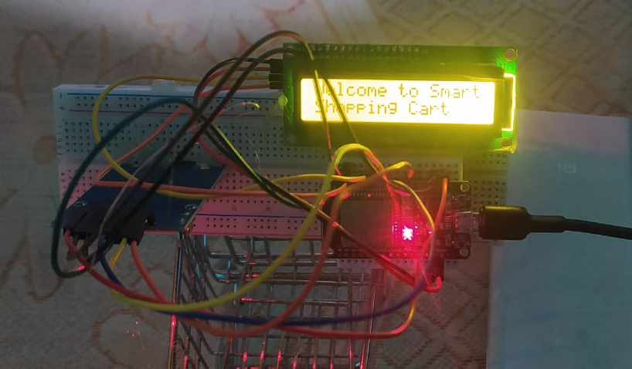
Experimental results:

Slide 22
Conclusion
The progression in science & technology development is an unstoppable process. Now & then evolution changing technologies are being invented. We cant imagine the upcoming future in which technology may occupy each & every place
This innovative project idea can be used is places like shopping complexes, supermarkets & malls to purchase the products.
RFID card is used to securely access every product in shopping places. If a product is scanned & put into the cart, all the required details of the product will be displayed on the LCD screen.
RFID tag/card is used for accessing the products. hence this project will help in improving the security & also the shopping

Slide 23
Reference
[1] CONTROL THERORY& INFORMATICS ISSN 2224- 5774(PRINT) ISSN2225-0492(ONLINE), VOL1, NO1, 2011 RFID Based Automatic Shopping Cart SAURABH KUMAR SULTAINA, GOURAV JAISWAL, PRATEEK JAIN
[2] INTERNATIONALCONFERENCE ON COMPUTING AND CONTROL ENGINEERING (ICCCE2012), 12&13 APRIL, 2012 Smart Shopping Experience Based On RFID.VANITHA
[3] THE SEVENTH INTERNATIONAL CONFERENCE ON SENSOR TECHNOLOGIES &APPLICATIONS Smart Shopping Cart For Automated Billing Purpose Using Wireless Sensor Networks, SANCHITA ROY,UDITA GANGWAL,JYOTSNA BAPATRobert Bakker, Edwin Keijsers, and Hans van der Beak “Alternativ .
[4] Dr.Suryaprasad J, Praveen Kumar B O, Roopa D Arjun A K, ANovel Low-Cost Intelligent Shopping
Cart, Proceedings of the 2nd IEEE International Conference on Networked Embedded Systems for Enterprise Applications, NESEA 2011, Perth,
Australia, December 8-9, 2011
[5] Swati Zope, Prof. .Maruti Limkar, “RFID based Bill Generation and Payment through Mobile”, International Journal of Computer Science and
Network (IJCSN), Volume 1, Issue 3, June 2012
[6] G. Roussos and B. College, “Enabling RFID in
Retail”, Computer, IEEE, vol. 39, no. 3, 2006, pp. 25-30.

Slide 24


Thank You

